Slide 1


Generative AI and Large Language Models
21
PART IV · DEEP LEARNING AND MODERN AI
CHAPTER 21 · WEEK 13
Data Science — From Foundations to Intelligent Systems
LECTURER
Dr. Mustafa Hameed
THE ISLAMIA UNIVERSITY OF BAHAWALPUR
Bahawalpur, Pakistan
Department of Information Technology · BSIT · Fall 2026
Notes:
Chapter 21: Generative AI and Large Language Models. Part 4 — Deep Learning and Modern AI. Week 13: Generative and agentic AI. Handout pages 134–140.

Slide 2

Where this chapter sits
THE COURSE
PART I
PART II
PART III
PART IV
PART V
PART VI
1
2
3
4
5
6
7
8
9
10
11
12
13
14
15
16
17
18
19
20
21
22
23
24
25
26
27
28
29
30
31
32
Generative AI and Large Language Models
BUILDS ON
USED LATER IN
Ch 18 Deep Architectures
Ch 22 Agentic AI
Ch 20 Text and Natural Language Processing
Data Science · Chapter 21 · Generative AI and Large Language Models
Handout p. 134 2
Notes:
Place the chapter. Before you start: Chapter 18 (attention and transformers) and Chapter 20 (embeddings — RAG is built on them).

Slide 3

What you will be able to do
LEARNING OUTCOMES
By the end of this chapter you will be able to:
1
Explain how an LLM produces text, and why that mechanism causes hallucination.
2
Distinguish pre-training, fine-tuning, prompting and retrieval, and choose between them.
3
Write effective prompts using role, context, task, format and examples.
4
Describe the RAG architecture and say which problem each component solves.
5
Evaluate a generative system despite the absence of a single correct answer.
Data Science · Chapter 21 · Generative AI and Large Language Models
Handout p. 134 3
Notes:
Read these out: they are the chapter's contract with the room. Each click adds one.

Slide 4

Vocabulary for this chapter
KEY TERMS
generative model
large language model
token
next-token prediction
temperature
context window
pre-training
fine-tuning
prompt engineering
zero/few-shot
chain of thought
reasoning model
structured output
hallucination
retrieval-augmented generation
vector database
re-ranking
grounding
Each term is defined where it first matters — not here.
Data Science · Chapter 21 · Generative AI and Large Language Models
Handout p. 134 4
Notes:
Do not define these now; they arrive one at a time. This slide is for the students' notes. Terms: generative model; large language model; token; next-token prediction; temperature; context window; pre-training; fine-tuning; prompt engineering; zero/few-shot; chain of thought; reasoning model; structured output; hallucination; retrieval-augmented generation; vector database; re-ranking; grounding.

Slide 5

In this chapter
IN THIS CHAPTER
21.1
How an LLM Actually Works
p. 134 ›
21.2
Four Ways to Adapt a Model
p. 135 ›
21.3
Prompting
p. 135 ›
21.4
Retrieval-Augmented Generation
p. 137 ›
21.5
Evaluating Generative Systems
p. 137 ›
Data Science · Chapter 21 · Generative AI and Large Language Models
Handout pp. 134–140 5
Notes:
The route through the chapter. Each row is a link: click it to jump to that section in the slide show.

Slide 6
How an LLM Actually Works
SECTION 1 OF 5
21.1
21.1 How an LLM Actually Works
21.2 Four Ways to Adapt a Model
21.3 Prompting
21.4 Retrieval-Augmented Generation
21.5 Evaluating Generative Systems
Data Science · Chapter 21
Handout §21.1 6
Notes:
Pause. Name the question this section answers.

Slide 7

Large Language Model
DEFINITION
A very large transformer (Chapter 18) trained on an enormous corpus with one objective: given a sequence of tokens, predict the next one. Text is generated by doing this repeatedly, each new token appended and fed back in.
Data Science · Chapter 21 · Generative AI and Large Language Models
§21.1 · Handout p. 134 7
Notes:
Read the box aloud, then ask for an example from the room before moving on.

Slide 8
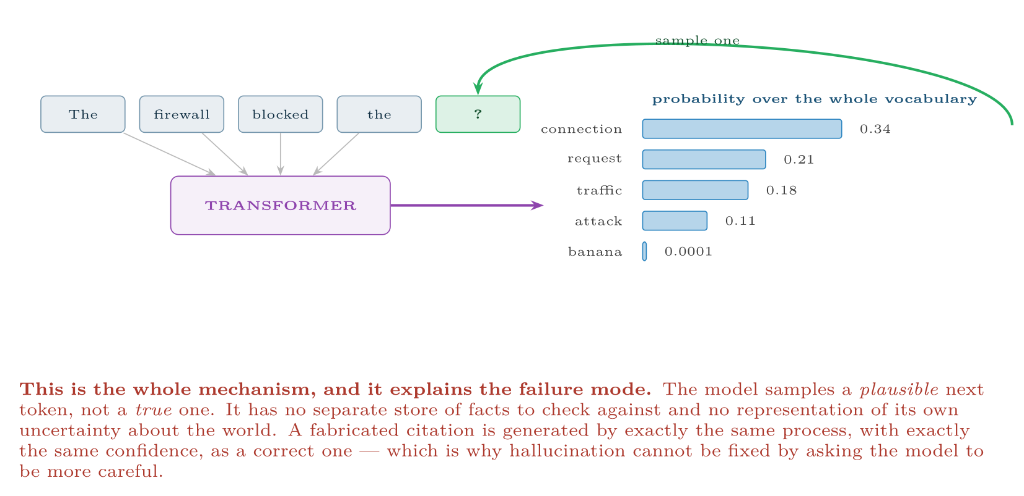
Next-token generation
FIGURE 21.1
The model outputs a probability distribution over its vocabulary and samples from it; the sampled token is appended and the process repeats. Fluency and truth are produced by the same mechanism, which is the central risk.
Data Science · Chapter 21 · Generative AI and Large Language Models
§21.1 · Handout p. 134 8
Notes:
Figure 21.1 (handout p. 135): Next-token generation. The model outputs a probability distribution over its vocabulary and samples from it; the sampled token is appended and the process repeats. Fluency and truth are produced by the same mechanism, which is the central risk.

Slide 9

Temperature
CONCEPT
Temperature controls how sharply the model samples. Near 0 it almost always takes the most likely token — repetitive but predictable, and the right setting for extraction, classification and code. Around 0.7–1.0 it samples more freely — varied and creative, and the right setting for drafting and brainstorming. Setting temperature is a task decision, not a style preference.
But temperature 0 is not a guarantee of identical output. Floating-point addition on a GPU is not associative, so when a request is batched with different neighbouring requests the sums are accumulated in a different order, the last bits of the scores change, and a close contest between two tokens can flip. If you need reproducibility — and an evaluation suite does — pin the model version, fix the seed where the provider offers one, record the exact prompt, and write your tests to accept semantically equivalent answers rather than byte-identical ones.
Data Science · Chapter 21 · Generative AI and Large Language Models
§21.1 · Handout p. 134 9
Notes:
Read the box aloud, then ask for an example from the room before moving on.

Slide 10
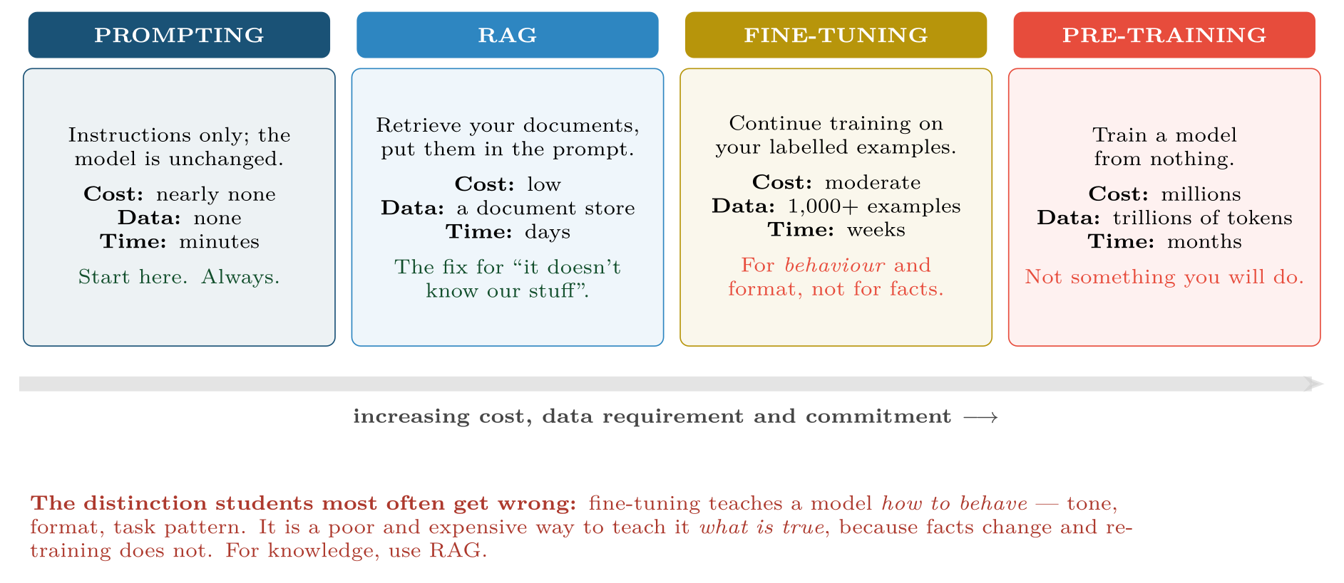
Four levels of adaptation
FIGURE 21.2
Work left to right and stop as soon as the problem is solved; most production systems never move past the second box.
Data Science · Chapter 21 · Generative AI and Large Language Models
§21.2 · Handout p. 135 10
Notes:
Figure 21.2 (handout p. 135): Four levels of adaptation. Work left to right and stop as soon as the problem is solved; most production systems never move past the second box.

Slide 11
Prompting
SECTION 3 OF 5
21.3
21.1 How an LLM Actually Works
21.2 Four Ways to Adapt a Model
21.3 Prompting
21.4 Retrieval-Augmented Generation
21.5 Evaluating Generative Systems
Data Science · Chapter 21
Handout §21.3 11
Notes:
Pause. Name the question this section answers.

Slide 12
The Five Components of a Good Prompt
DEFINITION
Role (who the model should act as), context (the background it needs), task (the specific instruction), format (the required output structure), and examples (one or more demonstrations). Missing components are the usual cause of a disappointing answer.
Data Science · Chapter 21 · Generative AI and Large Language Models
§21.3 · Handout p. 135 12
Notes:
Read the box aloud, then ask for an example from the room before moving on.

Slide 13

Improving a Prompt
WORKED EXAMPLE
Attempt 1 — vague.
Analyse this student data.
Result: a generic essay about what data analysis is. No role, no task, no format.
Attempt 2 — task added.
List which of these students are at risk of failing.
Result: a plausible-looking list with no stated reasoning and no way to check it. Better, but unusable and unauditable.
Attempt 3 — all five components.
Data Science · Chapter 21 · Generative AI and Large Language Models
§21.3 · Handout p. 135 13
Notes:
Each click adds one step of the working. Ask for the next number before you reveal it.

Slide 14
Improving a Prompt (continued)
WORKED EXAMPLE
Text
1
2
3
4
5
6
7
8
9
ROLE: You are an academic support adviser.
CONTEXT: Below are week-4 engagement records. Students fail mainly through
disengagement, not ability. We can contact at most 20 students.
TASK: Identify the 20 students most likely to fail. For each, give the
single strongest reason, drawn only from the data provided.
FORMAT: A markdown table: student_id | risk (high/medium) | reason | evidence
RULES: Use only the supplied data. If evidence is insufficient for a
student, write "insufficient data" rather than guessing.
EXAMPLE: S101 | high | stopped submitting in week 2 | 0 submissions wk2-4
Data Science · Chapter 21 · Generative AI and Large Language Models
§21.3 · Handout p. 135 14
Notes:
Each click adds one step of the working. Ask for the next number before you reveal it.

Slide 15
Improving a Prompt (continued)
WORKED EXAMPLE
Why attempt 3 works. The role sets vocabulary and stance; the context supplies the constraint (20 students) that makes the task well-posed; the format makes the output machine-readable and comparable; the rule against guessing gives the model an explicit alternative to hallucinating, which measurably reduces fabrication; the example removes ambiguity about what “reason” means.
And the limit. Even attempt 3 produces a drafting aid, not a risk model. It has no validated accuracy, no threshold chosen from costs, and no evaluation against outcomes. For an actual deployed risk score, use Chapter 14. Knowing which tool the problem calls for is the point.
Data Science · Chapter 21 · Generative AI and Large Language Models
§21.3 · Handout p. 135 15
Notes:
Each click adds one step of the working. Ask for the next number before you reveal it.

Slide 16
Chain of Thought, and What Reasoning Models Changed
CONCEPT
Adding “work through this step by step” measurably improves accuracy on multi-step reasoning, because the intermediate tokens give the model somewhere to do the work. It also makes the answer auditable: you can see where the reasoning went wrong instead of only that it did.
Reasoning models — the class of model that deliberates before answering, spending extra computation at answer time rather than extra parameters at training time — now do this internally, so asking them to think step by step adds little. Three consequences for you:
• Prompt them with the goal and the constraints, not with a procedure; over-specifying the steps can make them worse.
Data Science · Chapter 21 · Generative AI and Large Language Models
§21.3 · Handout p. 135 16
Notes:
Read the box aloud, then ask for an example from the room before moving on.

Slide 17
Chain of Thought, and What Reasoning Models Changed (continued)
CONCEPT
• They cost more and answer more slowly, so use them where the reasoning is the product (a plan, a diagnosis, a proof) and a cheaper model elsewhere.
• Their visible “thinking” is a summary of a process, not a transcript of it. Treat it as a useful explanation, never as evidence of what the model actually did.
The old advice still applies to ordinary models, which remain the right choice for most extraction and classification work.
Data Science · Chapter 21 · Generative AI and Large Language Models
§21.3 · Handout p. 135 17
Notes:
Read the box aloud, then ask for an example from the room before moving on.

Slide 18
Ask for Structured Output, Not Prose You Must Parse
CONCEPT
If the answer feeds a program rather than a person, do not ask for a markdown table and write a parser for it. Every major API now accepts a schema — a JSON shape the response is constrained to follow — so the model cannot return prose, cannot omit a required field, and cannot invent a category outside the list you gave. The same discipline as a database schema, applied to a probabilistic component: declare the shape, and validate on arrival anyway, because a schema constrains the form of the answer and never its truth.
Data Science · Chapter 21 · Generative AI and Large Language Models
§21.3 · Handout p. 135 18
Notes:
Read the box aloud, then ask for an example from the room before moving on.

Slide 19
Retrieval-Augmented Generation
SECTION 4 OF 5
21.4
21.1 How an LLM Actually Works
21.2 Four Ways to Adapt a Model
21.3 Prompting
21.4 Retrieval-Augmented Generation
21.5 Evaluating Generative Systems
Data Science · Chapter 21
Handout §21.4 19
Notes:
Pause. Name the question this section answers.

Slide 20
RAG
DEFINITION
Instead of relying on what the model absorbed in training, retrieve relevant passages from your own document store at query time and place them in the prompt. The model then answers from supplied evidence rather than from memory.
Data Science · Chapter 21 · Generative AI and Large Language Models
§21.4 · Handout p. 137 20
Notes:
Read the box aloud, then ask for an example from the room before moving on.

Slide 21
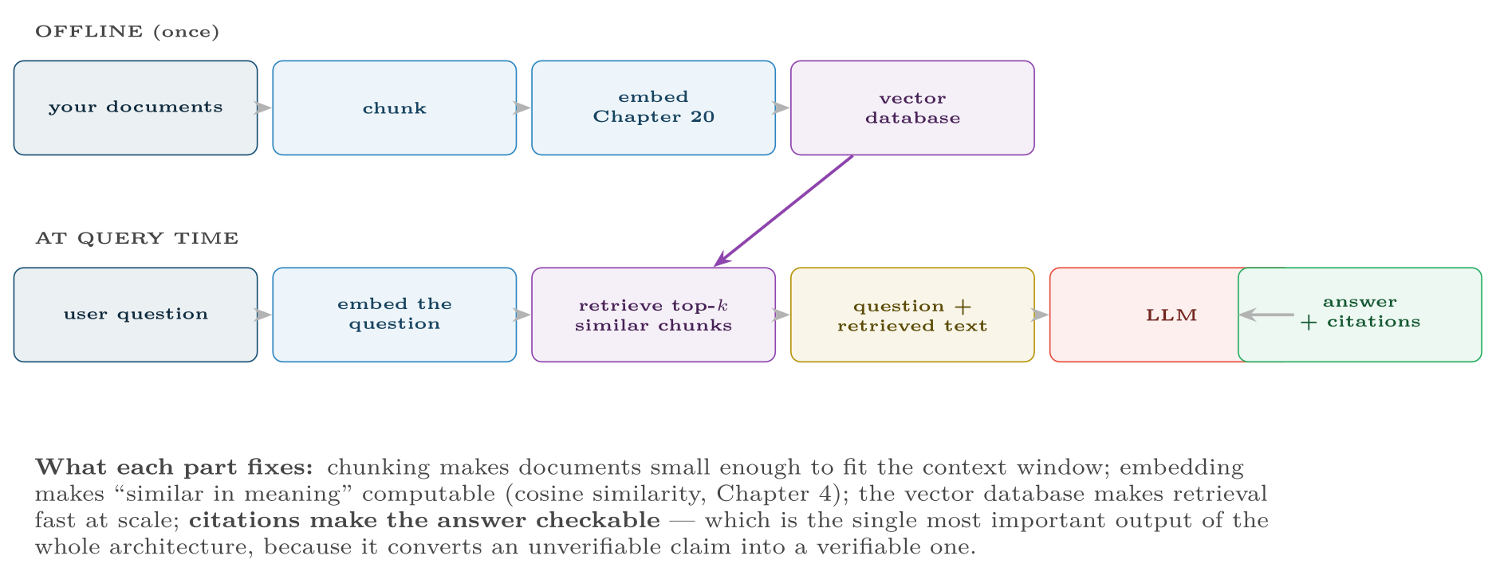
Retrieval-augmented generation
FIGURE 21.3
RAG solves three problems at once: the model does not know your private documents, its training data has a cutoff date, and its claims cannot otherwise be checked.
Data Science · Chapter 21 · Generative AI and Large Language Models
§21.4 · Handout p. 137 21
Notes:
Figure 21.3 (handout p. 137): Retrieval-augmented generation. RAG solves three problems at once: the model does not know your private documents, its training data has a cutoff date, and its claims cannot otherwise be checked.

Slide 22
“Can I Not Just Paste Everything In?”
CONCEPT
Context windows are now large enough to hold a small library, so students reasonably ask why retrieval is needed at all. Three reasons it still is. You pay for every token on every request, so pasting a handbook into each call is expensive. Models attend less reliably to material buried in the middle of a very long context than to material near its start or end, so more context can mean worse answers. And retrieval is what produces the citation, which is the output that makes the answer checkable.
The practical system is a hybrid: retrieve a generous set of candidates with keyword and vector search, re-rank them with a smaller model, and put only the best few into a long context window. Long context has raised the ceiling on how much evidence you can supply; it has not removed the need to choose the evidence.
Data Science · Chapter 21 · Generative AI and Large Language Models
§21.4 · Handout p. 137 22
Notes:
Read the box aloud, then ask for an example from the room before moving on.

Slide 23
Evaluating Generative Systems
SECTION 5 OF 5
21.5
21.1 How an LLM Actually Works
21.2 Four Ways to Adapt a Model
21.3 Prompting
21.4 Retrieval-Augmented Generation
21.5 Evaluating Generative Systems
Data Science · Chapter 21
Handout §21.5 23
Notes:
Pause. Name the question this section answers.

Slide 24

There Is No Accuracy Here
WATCH OUT
Chapter 14’s metrics assume one correct answer. A summary has many valid forms, so precision and recall do not apply. Generative evaluation is therefore multi-dimensional and partly human — and a project that has not planned for this has not planned to know whether it works.
Data Science · Chapter 21 · Generative AI and Large Language Models
§21.5 · Handout p. 137 24
Notes:
Read the box aloud, then ask for an example from the room before moving on.

Slide 25

Evaluating Generative Systems
AT A GLANCE
Dimension | Question | How to measure
Groundedness | Is every claim supported by the retrieved evidence? | Automated claim-to-source checking; the key metric for RAG
Relevance | Does it answer what was asked? | Human rating, or an LLM judge on a rubric
Correctness | Is it factually right? | Gold-answer set; expert review for a sample
Safety | Does it refuse what it should refuse? | Red-team prompt suite, run on every release
Consistency | Same question, same answer? | Repeat queries at temperature 0
Cost & latency | Affordable and fast enough? | Tokens per request, p95 response time
Data Science · Chapter 21 · Generative AI and Large Language Models
§21.5 · Handout p. 137 25
Notes:
Do not read the table row by row: pick the row the room is most likely to get wrong and ask why.

Slide 26

Common pitfalls
COMMON PITFALLS
✕
Treating fluency as accuracy. Confident, well-written and wrong is the characteristic failure.
✕
Fine-tuning to add facts. Use RAG; facts change, weights do not.
✕
Pasting confidential data into a third-party API. An acquisition and governance question (Chapter 28) that must be settled first.
✕
No human review for consequential output. Anything affecting a person’s grade, employment or security posture needs a human in the loop.
✕
Evaluating on the examples you used to write the prompt. That is the leakage of Chapter 7 in a new costume.
✕
Trusting an LLM judge you have never checked. Scoring answers with another model is cheap and scales, and it inherits the judge’s own biases — towards longer answers, towards its own style, and towards whichever option is listed first. Calibrate it against a few dozen human-scored examples before you believe any number it produces.
Data Science · Chapter 21 · Generative AI and Large Language Models
§21.5 · Handout p. 137 26
Notes:
For each pitfall, ask who has seen it happen. One real story beats five bullets.

Slide 27





Four lenses: Generative AI
FOUR LENSES
LEARNING ANALYTICS
PROJECT MANAGEMENT
Draft personalised feedback on assignments, generate practice questions at a target difficulty, and build a RAG tutor grounded strictly in the module’s own materials so it cannot invent content that is not on the syllabus.
Draft status reports from ticket data, summarise long requirement documents, and extract structured risk registers from meeting notes.
INTERNET OF THINGS
CYBERSECURITY
Less central here, but real: translating natural-language questions into telemetry queries, and generating human-readable incident summaries from raw sensor sequences.
Two-edged, and the only lens where the technology is used by both sides.
Data Science · Chapter 21 · Generative AI and Large Language Models
Handout p. 140 27
Notes:
The same method, four domains. Each of the next four slides opens one lens in full.

Slide 28

Learning Analytics: Generative AI
FOUR LENSES
LEARNING ANALYTICS
Project Management
Draft personalised feedback on assignments, generate practice questions at a target difficulty, and build a RAG tutor grounded strictly in the module’s own materials so it cannot invent content that is not on the syllabus. Firm limits: never let a generative model assign a grade unreviewed, and be explicit with students about where it is used. The fluency of the output makes it far more persuasive than its reliability warrants.
Internet of Things
Cybersecurity
Data Science · Chapter 21 · Generative AI and Large Language Models
Handout p. 140 28
Notes:
Learning Analytics. Draft personalised feedback on assignments, generate practice questions at a target difficulty, and build a RAG tutor grounded strictly in the module’s own materials so it cannot invent content that is not on the syllabus. Firm limits: never let a generative model assign a grade unreviewed, and be explicit with students about where it is used. The fluency of the output makes it far more persuasive than its reliability warrants.

Slide 29

Project Management: Generative AI
FOUR LENSES
PROJECT MANAGEMENT
Learning Analytics
Draft status reports from ticket data, summarise long requirement documents, and extract structured risk registers from meeting notes. RAG over the organisation’s own past project archives gives estimates a reference class it would otherwise lack. Keep temperature near 0 for anything that must be consistent between runs — a status report that changes wording every Monday erodes trust quickly.
Internet of Things
Cybersecurity
Data Science · Chapter 21 · Generative AI and Large Language Models
Handout p. 140 29
Notes:
Project Management. Draft status reports from ticket data, summarise long requirement documents, and extract structured risk registers from meeting notes. RAG over the organisation’s own past project archives gives estimates a reference class it would otherwise lack. Keep temperature near 0 for anything that must be consistent between runs — a status report that changes wording every Monday erodes trust quickly.

Slide 30

Internet of Things: Generative AI
FOUR LENSES
INTERNET OF THINGS
Learning Analytics
Less central here, but real: translating natural-language questions into telemetry queries, and generating human-readable incident summaries from raw sensor sequences. RAG over device manuals and past maintenance records puts the right procedure in a technician’s hands at the point of work. Note that LLM inference is far too heavy for edge devices — this runs in the cloud, on aggregated data (Chapter 24).
Project Management
Cybersecurity
Data Science · Chapter 21 · Generative AI and Large Language Models
Handout p. 140 30
Notes:
Internet of Things. Less central here, but real: translating natural-language questions into telemetry queries, and generating human-readable incident summaries from raw sensor sequences. RAG over device manuals and past maintenance records puts the right procedure in a technician’s hands at the point of work. Note that LLM inference is far too heavy for edge devices — this runs in the cloud, on aggregated data (Chapter 24).

Slide 31

Cybersecurity: Generative AI
FOUR LENSES
CYBERSECURITY
Learning Analytics
Two-edged, and the only lens where the technology is used by both sides. Defensively: summarise incidents, explain alerts to junior analysts, RAG over threat intelligence, draft detection rules. Offensively: attackers use the same models to write flawless phishing in any language, which has removed the spelling-error signal that classifiers relied on for twenty years. Add prompt injection to your threat model: if your assistant reads untrusted content, that content can contain instructions to it.
Project Management
Internet of Things
Data Science · Chapter 21 · Generative AI and Large Language Models
Handout p. 140 31
Notes:
Cybersecurity. Two-edged, and the only lens where the technology is used by both sides. Defensively: summarise incidents, explain alerts to junior analysts, RAG over threat intelligence, draft detection rules. Offensively: attackers use the same models to write flawless phishing in any language, which has removed the spelling-error signal that classifiers relied on for twenty years. Add prompt injection to your threat model: if your assistant reads untrusted content, that content can contain instructions to it.

Slide 32

Try it yourself: A Minimal RAG Pipeline
TRY IT YOURSELF
WHAT YOU WILL DO
1. Chunk your documents
2. Embed once, offline
3. Retrieve by cosine similarity (Chapter 4)
4. Build a grounded prompt
5. The evaluation you must not skip
THIS WEEK'S LAB
WHAT YOU WILL RUN
Week 13: Minimal RAG; agent loop with guardrails
1 listing, 47 lines of Python
Data Science · Chapter 21 · Generative AI and Large Language Models
§21.5 · Handout p. 137 32
Notes:
Say what the room will have at the end of the lab, then let them start. Circulate rather than lecture.

Slide 33
A Minimal RAG Pipeline
LAB · STEP 1 OF 6
Set-up
Python
1
import numpy as np
Data Science · Chapter 21 · Generative AI and Large Language Models
§21.5 · Handout p. 137 33
Notes:
Step 1: Set-up. Read the code aloud; ask what each line would print before running it.

Slide 34
A Minimal RAG Pipeline
LAB · STEP 2 OF 6
Chunk your documents
Python
2
3
4
5
6
7
# --- 1. chunk your documents ------------------------------------------
def chunk(text, size=800, overlap=100):
"""Overlap keeps sentences from being cut across a boundary."""
return [text[i:i+size] for i in range(0, len(text), size - overlap)]
chunks = [c for doc in documents for c in chunk(doc)]
Data Science · Chapter 21 · Generative AI and Large Language Models
§21.5 · Handout p. 137 34
Notes:
Step 2: Chunk your documents. Read the code aloud; ask what each line would print before running it.

Slide 35
A Minimal RAG Pipeline
LAB · STEP 3 OF 6
Embed once, offline
Python
8
9
10
11
# --- 2. embed once, offline -------------------------------------------
from sentence_transformers import SentenceTransformer
encoder = SentenceTransformer("all-MiniLM-L6-v2")
index = encoder.encode(chunks, normalize_embeddings=True) # (n_chunks, 384)
Data Science · Chapter 21 · Generative AI and Large Language Models
§21.5 · Handout p. 137 35
Notes:
Step 3: Embed once, offline. Read the code aloud; ask what each line would print before running it.

Slide 36
A Minimal RAG Pipeline
LAB · STEP 4 OF 6
Retrieve by cosine similarity (Chapter 4)
Python
12
13
14
15
16
# --- 3. retrieve by cosine similarity (Chapter 4) ---------------------
def retrieve(question, k=4):
q = encoder.encode([question], normalize_embeddings=True)[0]
scores = index @ q # normalised => dot product IS cosine
return [(chunks[i], float(scores[i])) for i in np.argsort(scores)[::-1][:k]]
Data Science · Chapter 21 · Generative AI and Large Language Models
§21.5 · Handout p. 137 36
Notes:
Step 4: Retrieve by cosine similarity (Chapter 4). Read the code aloud; ask what each line would print before running it.

Slide 37
A Minimal RAG Pipeline
LAB · STEP 5 OF 6
Build a grounded prompt
Python
17
18
19
20
21
22
23
24
25
26
27
28
29
30
31
32
33
34
35
# --- 4. build a grounded prompt ---------------------------------------
def build_prompt(question):
hits = retrieve(question)
evidence = "\n\n".join(f"[{i+1}] {c}" for i, (c, _) in enumerate(hits))
return f"""ROLE: You answer questions about our internal documentation.
CONTEXT (the ONLY permitted source):
{evidence}
QUESTION: {question}
RULES:
- Answer only from the context above.
- Cite the bracketed source number after each claim.
- If the context does not contain the answer, reply exactly:
"Not covered in the supplied documents."
"""
print(build_prompt("What is our password rotation policy?"))
Data Science · Chapter 21 · Generative AI and Large Language Models
§21.5 · Handout p. 137 37
Notes:
Step 5: Build a grounded prompt. Read the code aloud; ask what each line would print before running it.

Slide 38
A Minimal RAG Pipeline
LAB · STEP 6 OF 6
The evaluation you must not skip
Python
36
37
38
39
40
41
42
# --- 5. the evaluation you must not skip ------------------------------
# Build 30-50 question/answer pairs from documents you know. Measure:
# (a) retrieval hit rate -- was the right chunk in the top k at all?
# (b) groundedness -- is every claim traceable to a cited chunk?
# (c) refusal rate -- does it correctly refuse unanswerable questions?
# (a) is where most RAG systems actually fail; a perfect model cannot answer
# from evidence it was never given.
Data Science · Chapter 21 · Generative AI and Large Language Models
§21.5 · Handout p. 137 38
Notes:
Step 6: The evaluation you must not skip. Read the code aloud; ask what each line would print before running it.

Slide 39

Explain in two sentences why hallucination is a consequence of the generation mechanism rather than a bug to be patched.
CHECKPOINT 1 OF 3
Discuss with the person next to you, then advance.
Data Science · Chapter 21 · Generative AI and Large Language Models
Handout p. 140 · answers in Appendix D 39
Notes:
Ask the room. Do not advance until someone commits to an answer.

Slide 40

Explain in two sentences why hallucination is a consequence of the generation mechanism rather than a bug to be patched.
CHECKPOINT 1 OF 3 · ANSWER
The model samples the most plausible next token given the context; it has no separate fact store to check against and no representation of its own uncertainty about the world. A fabricated citation is produced by the same process, with the same fluency, as a correct one.
Data Science · Chapter 21 · Generative AI and Large Language Models
Handout p. 140 · answers in Appendix D 40
Notes:
Answer (Appendix D): The model samples the most plausible next token given the context; it has no separate fact store to check against and no representation of its own uncertainty about the world. A fabricated citation is produced by the same process, with the same fluency, as a correct one.

Slide 41
Your assistant does not know your company’s leave policy. Should you fine-tune or use RAG? Justify.
CHECKPOINT 2 OF 3
Discuss with the person next to you, then advance.
Data Science · Chapter 21 · Generative AI and Large Language Models
Handout p. 140 · answers in Appendix D 41
Notes:
Ask the room. Do not advance until someone commits to an answer.

Slide 42
Your assistant does not know your company’s leave policy. Should you fine-tune or use RAG? Justify.
CHECKPOINT 2 OF 3 · ANSWER
RAG. Fine-tuning teaches behaviour and format, not facts, and a policy that changes would require retraining every time. Retrieval also supplies citations, so the answer can be checked.
Data Science · Chapter 21 · Generative AI and Large Language Models
Handout p. 140 · answers in Appendix D 42
Notes:
Answer (Appendix D): RAG. Fine-tuning teaches behaviour and format, not facts, and a policy that changes would require retraining every time. Retrieval also supplies citations, so the answer can be checked.

Slide 43
You need the same answer for the same input every time. Set the temperature to 0 and you are most of the way there — but why is that still not a guarantee, and what else would you pin down?
CHECKPOINT 3 OF 3
Discuss with the person next to you, then advance.
Data Science · Chapter 21 · Generative AI and Large Language Models
Handout p. 140 · answers in Appendix D 43
Notes:
Ask the room. Do not advance until someone commits to an answer.

Slide 44
You need the same answer for the same input every time. Set the temperature to 0 and you are most of the way there — but why is that still not a guarantee, and what else would you pin down?
CHECKPOINT 3 OF 3 · ANSWER
Temperature 0, so the model takes the highest-probability token rather than sampling — the right setting for extraction, classification and anything that must be consistent between runs. It is not a guarantee, though: GPU floating-point addition is not associative, so batching your request with different neighbours changes the order of the sums and can flip a close contest between two tokens. Pin the model version, fix any seed the provider offers, keep the prompt under version control, and judge your evaluation suite on semantic equivalence rather than byte-identical text.
Data Science · Chapter 21 · Generative AI and Large Language Models
Handout p. 140 · answers in Appendix D 44
Notes:
Answer (Appendix D): Temperature 0, so the model takes the highest-probability token rather than sampling — the right setting for extraction, classification and anything that must be consistent between runs. It is not a guarantee, though: GPU floating-point addition is not associative, so batching your request with different neighbours changes the order of the sums and can flip a close contest between two tokens. Pin the model version, fix any seed the provider offers, keep the prompt under version control, and judge your evaluation suite on semantic equivalence rather than byte-identical text.

Slide 45

What to take away
CHAPTER SUMMARY
1
An LLM samples the next token from a learned distribution. Fluency and fabrication come from the same mechanism.
2
Temperature trades determinism against variety and should be set from the task.
3
Adapt in order: prompting, then RAG, then fine-tuning. Fine-tuning teaches behaviour, not facts.
4
A good prompt has role, context, task, format and examples, plus an explicit instruction on what to do when evidence is missing.
5
RAG grounds answers in your own documents and, crucially, makes them checkable through citations.
6
Generative systems have no single correct answer, so evaluate across groundedness, relevance, correctness, safety, consistency and cost — with humans in the loop for consequential output.
Data Science · Chapter 21 · Generative AI and Large Language Models
Handout p. 140 45
Notes:
Ask the room to say each takeaway before you reveal it.

Slide 46

Quick check 1 of 2
REVIEW · MULTIPLE CHOICE
An LLM generates text by:
A
looking up facts in a database
B
predicting the next token repeatedly
C
searching the web
D
translating from an internal logic
Data Science · Chapter 21 · Generative AI and Large Language Models
Handout p. 140 46
Notes:
Take a show of hands for each option before discussing. (The handout does not print MCQ answers.)

Slide 47
Quick check 2 of 2
REVIEW · MULTIPLE CHOICE
To make a model answer from your private, frequently-updated documents, the appropriate technique is:
A
pre-training
B
fine-tuning
C
RAG
D
raising the temperature
Data Science · Chapter 21 · Generative AI and Large Language Models
Handout p. 140 47
Notes:
Take a show of hands for each option before discussing. (The handout does not print MCQ answers.)

Slide 48
For your notebook
REVIEW QUESTIONS
SHORT
Name the five components of a well-formed prompt and say what each contributes.
SHORT
Explain why citations are the most valuable output of a RAG system.
SHORT
Give two reasons why generative systems cannot be evaluated with precision and recall.
APPLIED
Design a RAG assistant that answers student questions about a module. Specify the document store, chunking strategy, retrieval method, prompt rules, and the three evaluation measures you would report — plus the one failure mode you would monitor most closely.
APPLIED
Your security team wants an LLM to summarise alerts. Write the threat model: list three ways this could be attacked or could fail dangerously, and state a mitigation for each.
Data Science · Chapter 21 · Generative AI and Large Language Models
Handout p. 140 48
Notes:
Set these for independent study. Model answers are not printed in the handout.

Slide 49
End of Chapter 21
21
NEXT
READ
Chapter 22 — Agentic AI
Handout Chapter 21, pages 134–140
THIS WEEK'S LAB
ASSESSMENT
Minimal RAG; agent loop with guardrails
Quiz 2 (Ch 17–22)
Data Science · Chapter 21 · Generative AI and Large Language Models
49
Notes:
Close. NEXT: Chapter 22 — Agentic AI. READ: Handout Chapter 21, pages 134–140. THIS WEEK'S LAB: Minimal RAG; agent loop with guardrails. ASSESSMENT: Quiz 2 (Ch 17–22).

